Slide 1
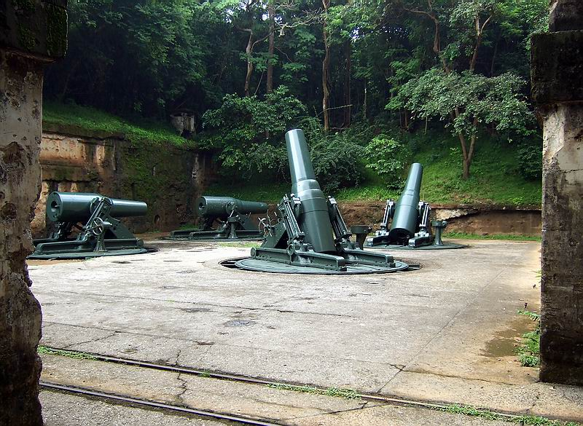
Fortress SQL Server
Using Security Best Practices to Lockdown Your Databases and Applications
K. Brian Kelley
Charlotte SQL Server User Group
17 February 2009

Slide 2
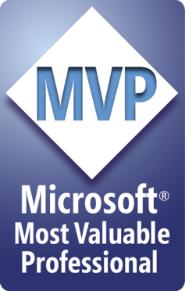
My Background
Now:
Microsoft SQL Server MVP - 2009
Database Administrator / Architect (again, and much happier)
Formerly:
Infrastructure and security architect
Incident response team lead
Certified Information Systems Auditor (CISA)
SQL Server security columnist / blogger
SQLServerCentral.com
MSSQLTips.com
Co-Author of How to Cheat at Securing SQL Server 2005 (Syngress)
Authentication
DDL and Login Triggers
Co-Author of Professional SQL Server 2008 Administration (Wrox) – Securing the Database Engine

Slide 3
Agenda
Review of Basic Security Principles
Qualitative vs. Quantitative Risk Assessment
Threat Vectors
Protecting the Server
What We Can Do within SQL Server

Slide 4
Security principles
A Brief Coverage of

Slide 5
The C-I-A Triad

Slide 6
Principle of Least Privilege
Only what’s needed. No less, no more.
Too little and the job doesn’t got done.
Too much, and you’ve increased your risk!

Slide 7
Defense in Depth
Security is like an onion. It has layers.
Not just more, but different, too.
Think about the old game Breakout.

Slide 8
Risk Assessment
Two Types of

Slide 9
Qualitative Risk Assessment
We can describe what can happen.
We can make general assumptions to the likelihood, impact, and cost.
But we can’t give hard numbers
We techies can live with this.
The business side usually can’t.

Slide 10
Qualitative Example
An attacker breaches our web application:
Gets personal identification data
Gets credit card numbers
We know we’re good, so we say it’s not very likely. What exactly does that mean?
We know the company is going to take a publicity hit. How much will it cost?
Can we measure any of this?

Slide 11
Quantitative Risk Assessment
How likely is an incident to occur in a year?
How much damage will we suffer?
Looking for reasonable estimates.
Business likes this a lot.
Allows us to justify spending more resources.
Harder to do, but obviously worth it.

Slide 12
Quantitative Example
An attacker breaches our web application:
Gets personal identification data
Gets credit card numbers
Likelihood Estimate: Once every 3 years
Cost: $43.5M
Customer Notification: $1.5M
Loss of Business: $37M
Fix Security Hole: $5M
Annual Loss Expectancy = $43.5M / 3 = $14.5M
Think we can get that extra 6 weeks for code review / security fixes now?

Slide 13
Threat vectors
Finding your inner ninja or thinking about

Slide 14
Threat Vectors
Means of attacking the system (or the users)
First, brainstorm. Don’t throw anything out.
Second, consider likelihood.
Third, estimate damage.
Fourth, determine defenses.
Fifth, calculate expense.

Slide 15
Back to Our Example
Web Application obvious attacks:
SQL injection
Cross-site scripting
Attack web server directly
Attack OS directly
Phishing attack on user
Get an admin to click on a malicious link and steal information
Trojan Horse on user
Happened with Valve on Half-Life 2. It can happen to you.

Slide 16
Securing the Server Itself
Building a hard shell, or,

Slide 17
Let’s Talk Operating System
The Basics
What is Often Missed
When You Really Have to Lock it Up

Slide 18
OS Basics
Keep the OS Patched
MS08-067 (Oct 2008) – Big problem
SQL Server is usually not the issue!
Know who is in the Administrators group
Know who is in the Power Users group
From the 10 Immutable Laws of Security:
Law #2: If a bad guy can alter the operating system on your computer, it's not your computer anymore
Law #6: A computer is only as secure as the administrator is trustworthy

Slide 19
What about MS09-004?
Affects SQL Server 2000 SP4 and 2005 SP2
SQL Server 2005 SP3 includes the fix
SQL Server 2008 not affected
Vulnerability in a replication extended stored procedure
Buffer overflow attack
Must be logged on to SQL Server to use it.
Workarounds are to drop or restrict access (DENY EXECUTE) to: sp_replwritetovarbin

Slide 20
What is Often Missed
What other apps are installed?
IIS – SQL Server Reporting Services
Backup Agents
Monitoring Agents
Network Shares
Know who is in Remote Desktop Users
Know who can get physical access:
Law #3: If a bad guy has unrestricted physical access to your computer, it's not your computer anymore – also from the 10 Immutable Laws of Security

Slide 21
What Else?
Bitlocker / EFS - Encryption
IPSEC Policy
Host-Based Intrusion Prevention
Automated Audits
Group Policy- Enforce Settings

Slide 22
Technical security solutions for sql server
We interrupt this station to look at

Slide 23
For the DBA
Server Level Security
Database Level Security
Auditing Logins

Slide 24
Server Level Security
Surface area is critical
Surface Area Configuration Tool (2005)
Surface Area Configuration facet and Policy Management (2008)
Use Windows authentication only (if you can)
SA account
Strong password even if Windows auth only
Registry hack all it takes to change behavior
No one should know this password
Make it impossible to remember (password generator)
Store it away safely in case you do need it
Two people generated
Rename & Disable if possible (SQL Server 2005/2008)

Slide 25
Server Level Security
Control membership for SysAdmin
BUILTIN\Administrators – What to do?
Cluster service account – not necessary
Local System – necessary for Full Text (SQL 2000)
Keep track of membership of all fixed server roles
ProcessAdmin
SecurityAdmin
ServerAdmin
Use sp_helpsrvrolemember system stored procedure

Slide 26
Server Level Security
SQL Server 2005 and above – Server securable
Permissions granted at a granular level.
Not necessarily rolled to a server role
Query:
SELECT
prin.name [Login],
perm.permission_name,
perm.state_desc
FROM sys.server_permissions perm
JOIN sys.server_principals prin
ON perm.grantee_principal_id = prin.principal_id
ORDER BY [Login], permission_name

Slide 27
Server Level Security
Track ALL logins to SQL Server
Understand extent of mappings for Windows security groups
Can nest many, many levels. Track ‘em all down.
Users can have multiple security groups.
Work with system / directory administrators.
Where to look:
SQL Server 2000: syslogins
SQL Server 2005/8: sys.server_principals, sys.sql_logins

Slide 28
Server Level Security
SQL Server 2000 query:
SELECT
name,
CASE isntname
WHEN 0 THEN 'N' ELSE 'Y' END [Windows_Account],
CASE denylogin
WHEN 0 THEN 'N' ELSE 'Y' END [Login_Denied]
FROM syslogins

Slide 29
Server Level Security
SQL Server 2005/8 query:
SELECT
name,
'Y' [Windows_Account], 'Y' [Account_Policy],
'Y' [Password_Expiration]
FROM sys.server_principals
WHERE type IN ('G', 'U')
UNION ALL
SELECT
name, 'N',
CASE is_policy_checked WHEN '0' THEN 'N' ELSE 'Y' END,
CASE is_policy_checked WHEN '0' THEN 'N'
ELSE CASE is_expiration_checked
WHEN '0' THEN 'N' ELSE 'Y' END END
FROM sys.sql_logins

Slide 30
Database Level Security
Transparent Data Encryption in SQL Server 2008 EE
Understand difference between dbo and db_owner
Sysadmin role members map in as dbo
Database roles to keep track of:
db_ddladmin
db_owner
db_SecurityAdmin
Use sp_helprolemember to list members
Don’t allow guest user
Exceptions: master, tempdb, msdb

Slide 31
Database Level Security
Like logins, track all users
Determine their mappings to logins
Track all roles – remember, they can nest!
Determine what users are members of what roles
Aggregate of these determines permissions within a database
Often important for compliance monitoring

Slide 32
Database Level Security
SQL Server 2000 query:
SELECT
sl.name [Login], su.name [User]
FROM master..syslogins sl
JOIN sysusers su
ON sl.sid = su.sid
WHERE hasdbaccess = 1
AND issqlrole = 0

Slide 33
Database Level Security
SQL Server 2005/8 query:
SELECT
sprin.name [Login], dprin.name [User]
FROM sys.database_principals dprin
LEFT JOIN sys.server_principals sprin
ON dprin.sid = sprin.sid
WHERE dprin.type NOT IN ('A', 'R')

Slide 34
Database Level Security
Watch for Cross Database Ownership Chaining
Mandatory for master, msdb and tempdb
Do not turn on server wide
Owner of database is the login for dbo-owner objects (reason against same login owning every database)
Check at both server and database level
Server: sp_configure ‘cross db ownership chaining’
DB: sp_dboption [Database Name], ‘db_chaining’

Slide 35
Database Level Security
Mapping Permissions
SQL Server 2000:
sp_helprotect does it all
Syspermissions can be used, too
SQL Server 2005/8:
sp_helprotect isn’t the answer. Misses SQL Server 2005 securables (schemas, database)
Sys.database_permissions
Key on class
Schema_name()
Object_name()

Slide 36
Using sys.database_permissions
SELECT class_desc , CASE WHEN class = 0 THEN DB_NAME() WHEN class = 1 THEN OBJECT_NAME(major_id) WHEN class = 3 THEN SCHEMA_NAME(major_id) END [Securable] , USER_NAME(grantee_principal_id) [User] , permission_name , state_desc FROM sys.database_permissions

Slide 37
Implicit Permissions
dbo
No blocking even using DENY
db_owner
Access unless blocked with DENY
db_datareader
SELECT against all tables & views unless blocked with DENY
db_datawriter
INSERT, UPDATE, and DELETE against all tables & views unless blocked with DENY

Slide 38
Auditing Logins
Not a Setting within SQL Server
Stored in the Registry
Must use GUI to change values
Requires SQL Server restart to take effect
Records Events in Application Event Log
SQL Server 2000:
Information Event ID 17055
Must read details on event entry to see success/failure
SQL Server 2005/8:
Audit Success Event ID 18453
Audit Failure Event ID 18456
Audit Failures at a Minimum
Shiny, new Audit object in SQL Server 2008 EE!

Slide 39
For the Developer
Logins vs. Users
Protect the Credentials
Database Roles
Principle of Least Privilege
Ownership Chains
Securables

Slide 40
Logins vs. Users
Logins allow access to SQL Server
Called Server Principals in SQL Server 2005/8
SQL Server Logins
Windows Logins
Windows Users
Windows Security Groups
Users allow access to a Database
Called Database Principals in SQL Server 2005/8
Usually Mapped to a Login
Doesn’t Have to be in SQL Server 2005/8

Slide 41
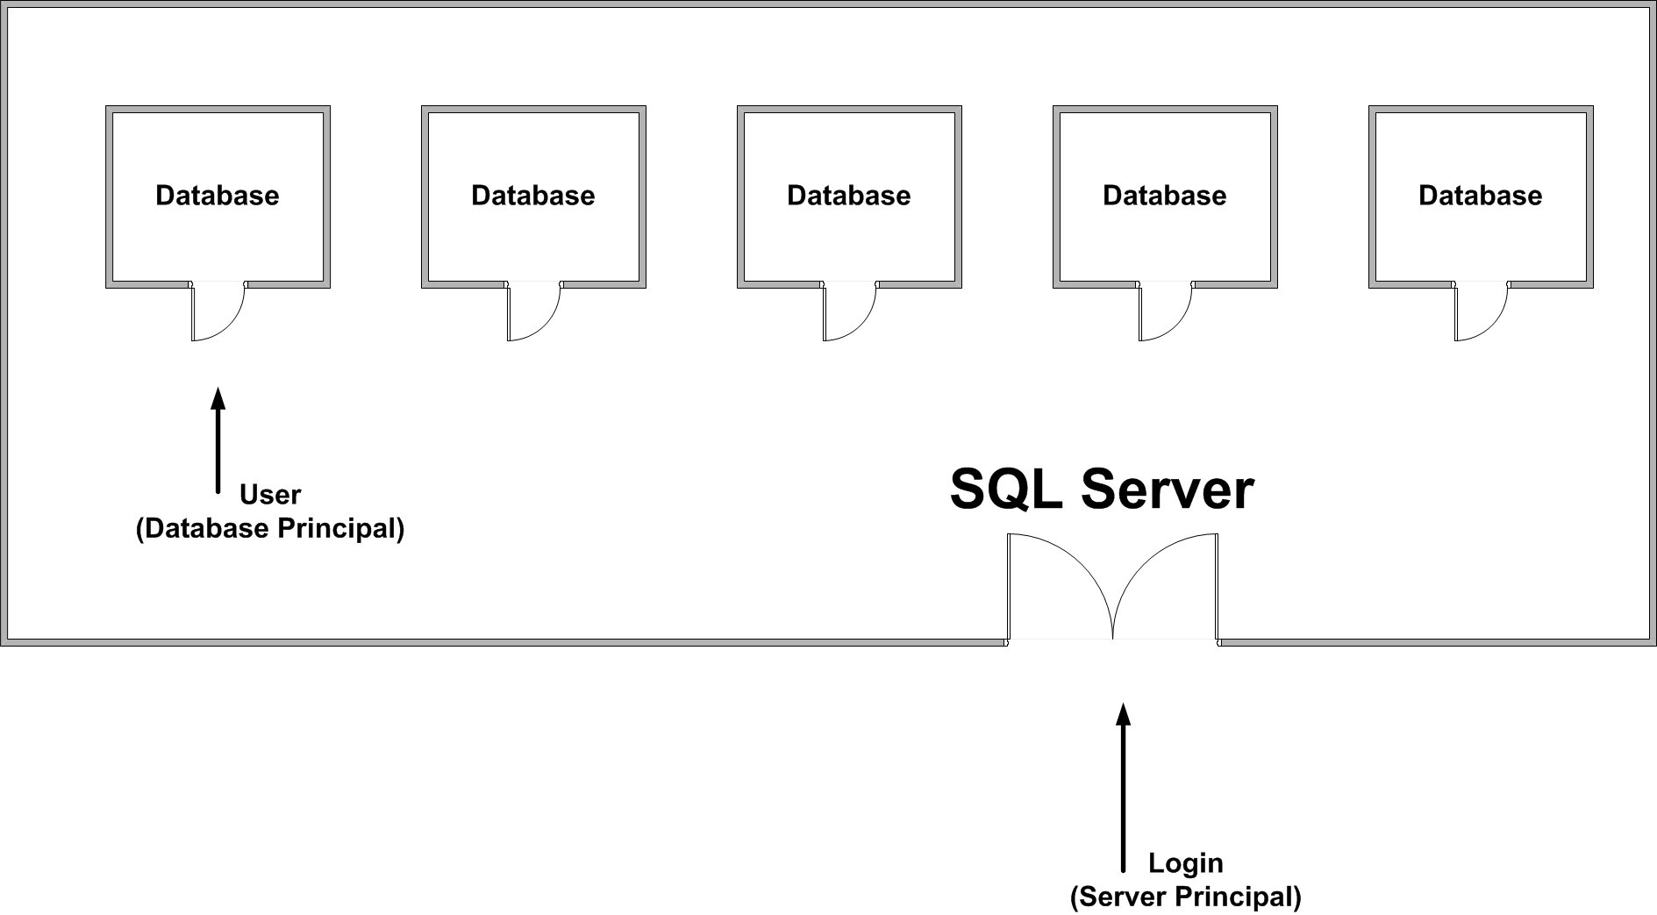
Logins vs. Users

Slide 42
Protect the Credentials
Use Windows authentication whenever possible
Just because Microsoft does it doesn’t make it acceptable
If SQL Server authentication is required, never store the credentials in plain-text
Especially avoid plain-text in logical places:
*.config
*.ini
An attacker can use Search against you, so really no where is safe
Encrypt the credentials!
ASPNET_IISREG is your friend
If you go the do it yourself route, ensure the encryption protocol is sound
Compiling it into the application is not secure (Google for “hex editor”)

Slide 43
Database Roles
Like Security Groups in Windows
Contains a group of database users
User-defined database roles can be nested
Best practice says to build logical roles and assign permissions accordingly
Same idea as Windows groups for permissions
Do not use Public role
Stay away from db_datareader and db_datawriter

Slide 44
Database Roles
Example: State Park Cabin Reservations
Three Levels of Access
Web Registration
Can submit a reservation (cannot override)
Can cancel a reservation
Can view all reservation details without sensitive data
Assisted Registration
Can submit a reservation (cannot override)
Can edit a reservation (cannot override)
Can cancel a reservation
Can view all reservation details, including credit card
Park Ranger
Can submit a reservation (can override)
Can edit a reservation (can override)
Can cancel a reservation
Can view all reservation details, including credit card

Slide 45
Database Roles
Example: State Park Cabin Reservations
Three Database Roles
Web Registration: Web User
Assisted Registration: Reservation Agent
Park Ranger: Park Ranger
Creating Roles:
SQL Server 2000: sp_addrole
SQL Server 2005/8: CREATE ROLE
Adding members to a role:
All 3: sp_addrolemember

Slide 46
Principle of Least Privilege
Don’t use sa. Ever. There is no reason for this
Just because a commercial company (even a security company) does it doesn’t make it right.
Don’t use dbo. There is usually no reason for this. Even if Microsoft does!
Don’t use db_owner role members. See dbo.
Explicitly define permissions against roles.
Only grant the rights needed to do the job.
Use ownership chaining!

Slide 47
Ownership Chaining
Security mechanism specific to SQL Server
Recommended best practice
Prevents direct access to base tables
Reduces number of permissions checks
How it works:
When one object refers to another, SQL Server may not perform a security check on the object referred to
Differs between SQL Server 2000 and 2005/8

Slide 48
Ownership chaining
SQL Server 2000:
SQL Server checks the owner of the objects
If the owner is the same, no security check on the referred to object is no performed.
SQL Server 2005/8:
Objects are no longer owned (user/schema separation)
Objects are part of a schema
Schema owners are checked instead
If the owner is the same for both schema (or if the objects are in the same schema), no security check on the referred to object is performed.

Slide 49
Ownership chaining
Ownership Chain (Always):
Test.usp_AProc
Test.ATable
NOT an Ownership Chain in SQL 2000:
Test.usp_SecondProc
X
Test2.SecondTable

Slide 50
Ownership chaining
Ownership Chain (Always):
Test.usp_AProc
Test.ATable
Can be an Ownership Chain in SQL 2005/8:
Test.usp_SecondProc
Test2.SecondTable
As long as Test and Test2 schemas have the same owner!

Slide 51
Ownership chaining
Implications:
We can create stored procedures and views which refer to the base tables.
Users need permission to the stored procedures and views.
Access is controlled via the stored procedures and views.
Base tables can be altered indirectly through the stored procedures and views.
No permissions are needed against the base tables.

Slide 52
Securables
SQL Server 2005 introduced a new, granular permission model
Two types of securables:
Scopes
Securables themselves
Scopes are containers:
Server
Database
Schema

Slide 53
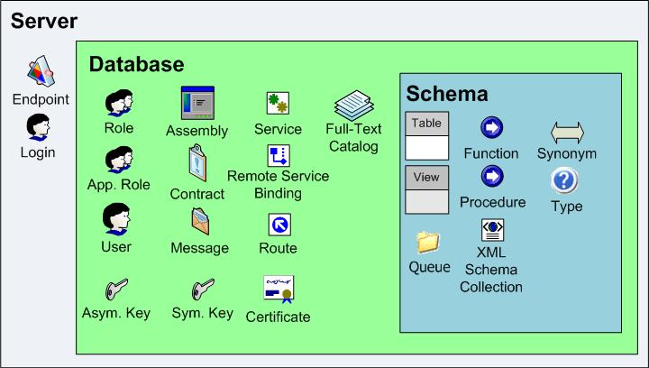
Securables

Slide 54
Securables
Best Practices:
Use schema to break up objects (namespaces)
Apply permissions at the schema level
Use Ownership Chaining
Apply permissions using database roles
Put users in the appropriate roles
Considerations:
Namespaces (schema) don’t fit with permission model
Temporary exceptions

Slide 55
Any Questions?
If you’re still awake…
Contact Information:
K. Brian Kelley
kbriankelley@acm.org
http://www.truthsolutions.com/
http://twitter.com/kbriankelley/

